Slide 1
Communication overview

Slide 2
We don’t really know what culture is.
The problem we have with culture, a fish has with water

Slide 3

The problem we have with culture, a fish has with water

Slide 4
A fish is IN water: it‘s not AWARE of it

Slide 5
The problem we have with culture, a fish has with water

Slide 6
It’s the same thing with us and culture

Slide 7
We are IN IT, but we are not AWARE of it

Slide 8
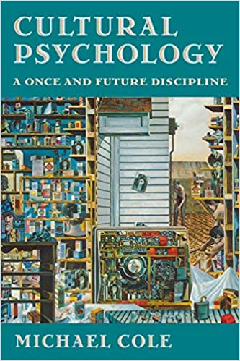
Cultural psychologists are interested in how mind is SHAPED by culture

Slide 9
Lev Vygotsky proposed that all mental development takes place in culture

Slide 10
Cultural psychologists are not really interested in psychological universals

Slide 11
Mind develops in culture

Slide 12

Mind and culture cannot be separated

Slide 13
We are VERY different from each other

Slide 14
Communication is difficult

Slide 15
We have to work hard at it

Slide 16
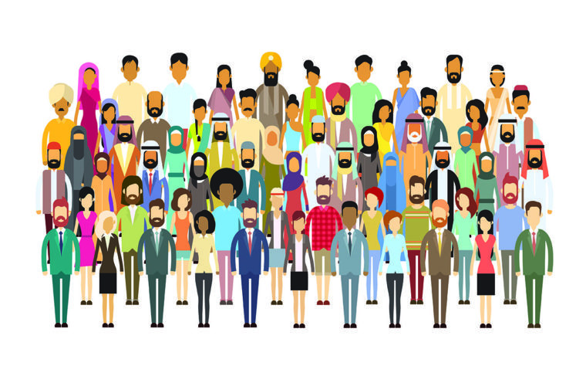
We have to understand others

Slide 17
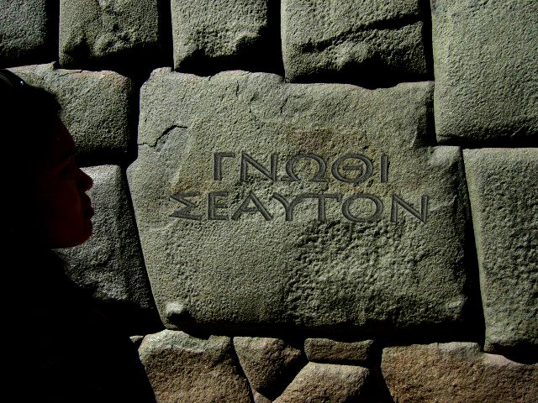
We have to understand OURSELVES

Slide 18
Know thyself

Slide 19
Know thyself: be honest with yourelf

Slide 20
Know thyself: The Temple of Appollo at Delphi (Ancient Greece)

Slide 21
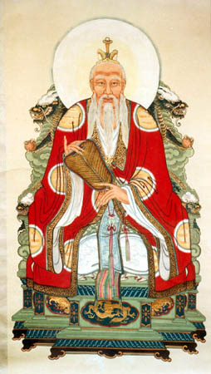
Lao Tsu: Knowing others is intelligence

Slide 22
Lao Tsu: Knowing yourself is true wisdom

Slide 23
Lao Tsu: Mastering others is strength

Slide 24
Lao Tsu: Mastering yourself is true power

Slide 25
Lao Tsu: (Ancient China)

Slide 26
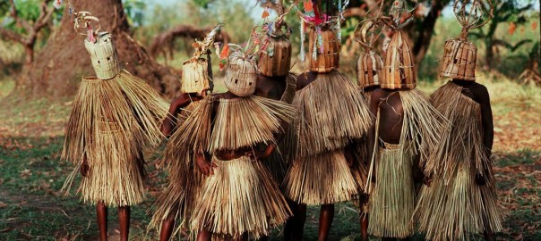
So understanding others is important

Slide 27
But understanding yourelf is more important

Slide 28
Be honest with yourself

Slide 29
Communication
Transfer of information
Output
Input

Slide 30
Human language
Four skills
Writing
Reading
Speaking
Listening

Slide 31
You’ve got to try
Do your best to get your meaning across in writing
Do your best to understand what is written down
Do your best to get your meaning across in speaking
Do your best to understand what is said to you

Slide 32
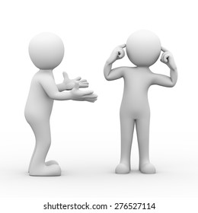
This is a problem

Slide 33
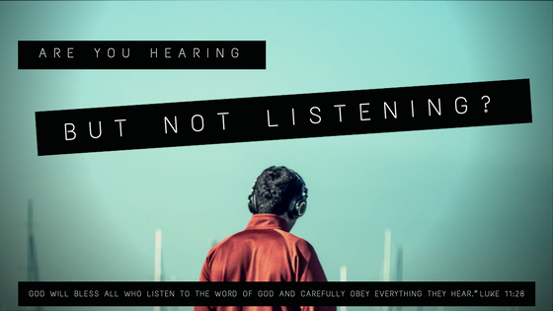
Hearing and listening

Slide 34
Hearing and listening: not the same

Slide 35
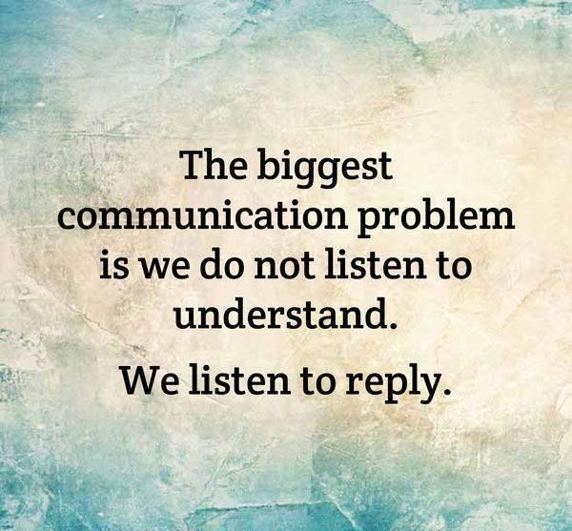

Slide 36
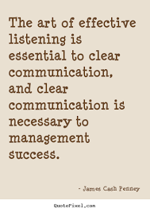
Listening is the key skill

Slide 37
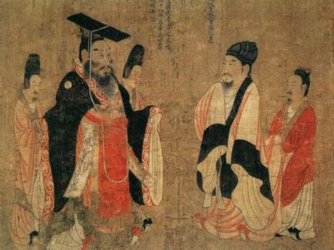
Ancient China

Slide 38
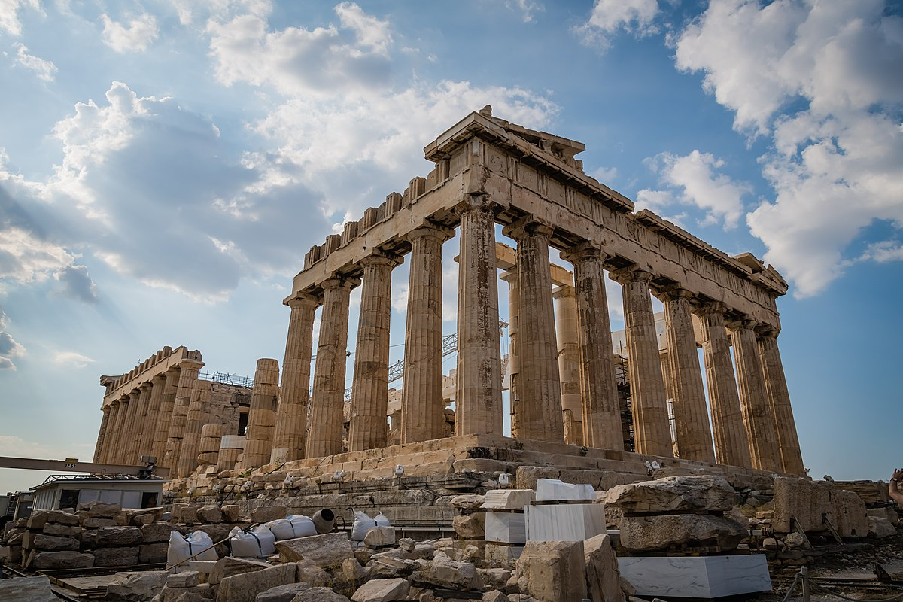
Ancient Greece

Slide 39
Understand yourself

Slide 40
Understand yourself

Slide 41

Are cultural differences real?

Slide 42
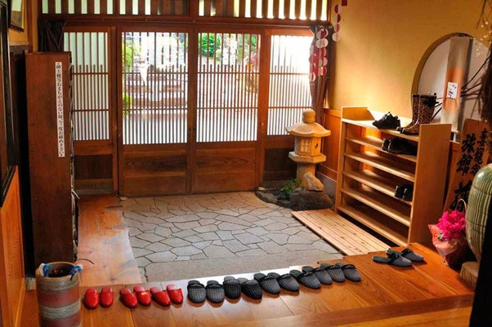
Or just superficial?

Slide 43
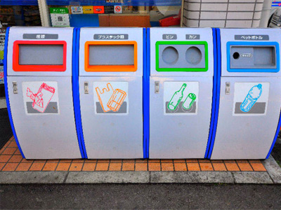
Why so few trash cans?

Slide 44
People are expected to take care of their own trash?

Slide 45
Lao Tsu: Mastering yourself is true power

Slide 46
Lao Tsu: Master your trash!

Slide 47

Train etiquette

Slide 48
Social harmony seems more important

Slide 49
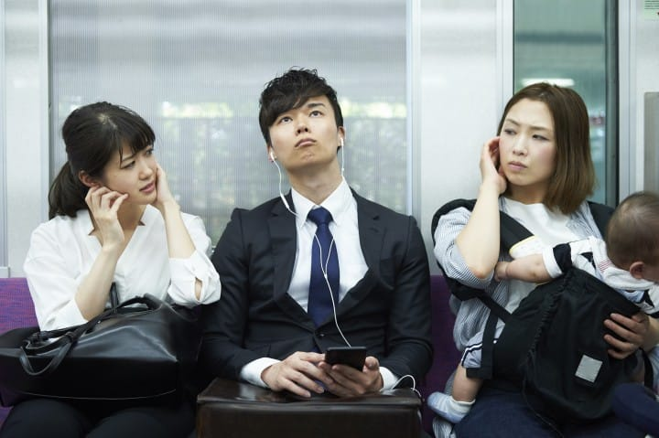
Seems very strict to me

Slide 50
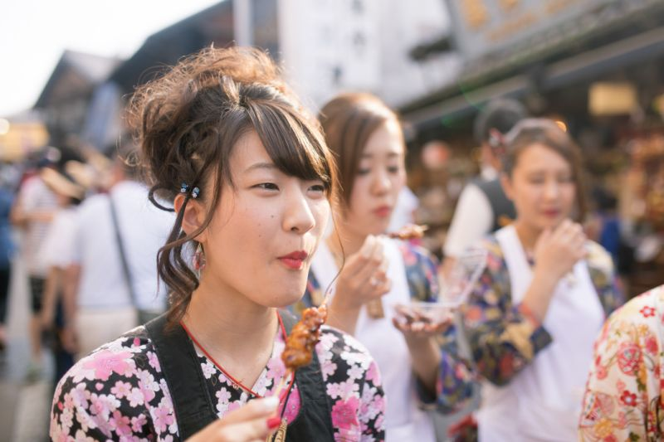
Eating while walking – OK or not?

Slide 51
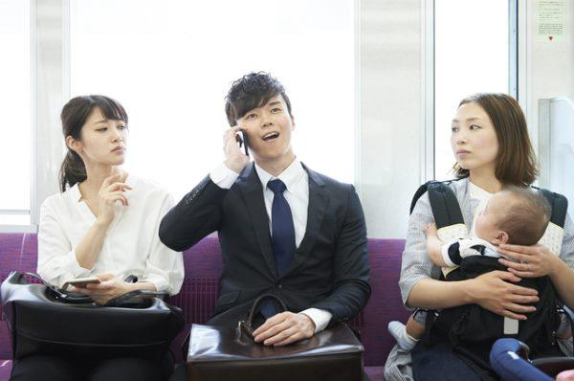
This seems very strict to me

Slide 52
I notice people complaining more than actually doing it!

Slide 53
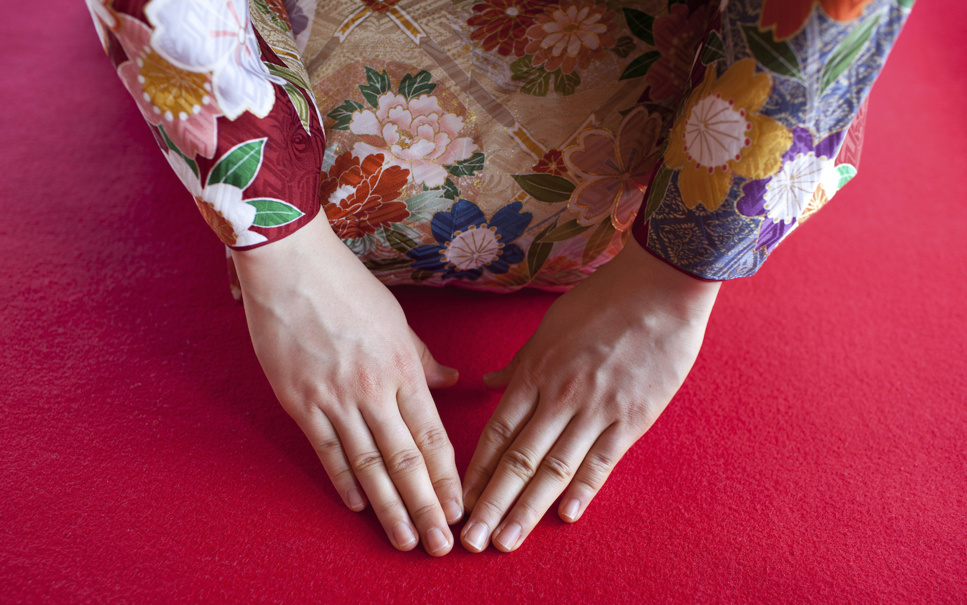
But where do these differences come from?

Slide 54
Deep in history

Slide 55
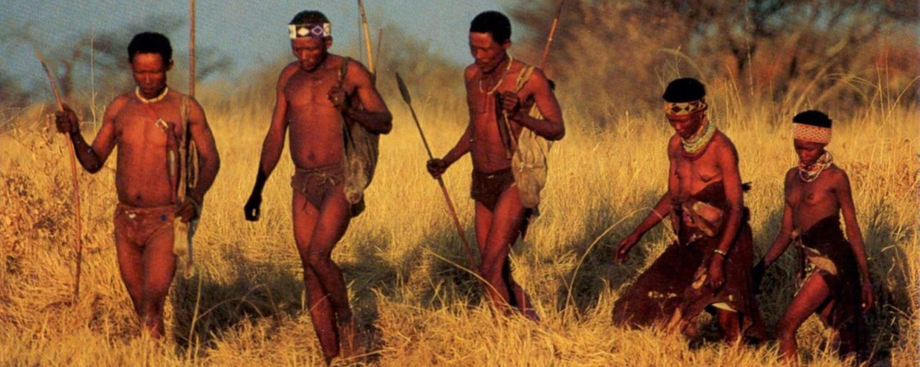
For thousands of years …

Slide 56
… we lived like this

Slide 57
Hunter gatherers: hunting animals, gathering fruit and nuts etc.

Slide 58
When the food is gone, move on

Slide 59
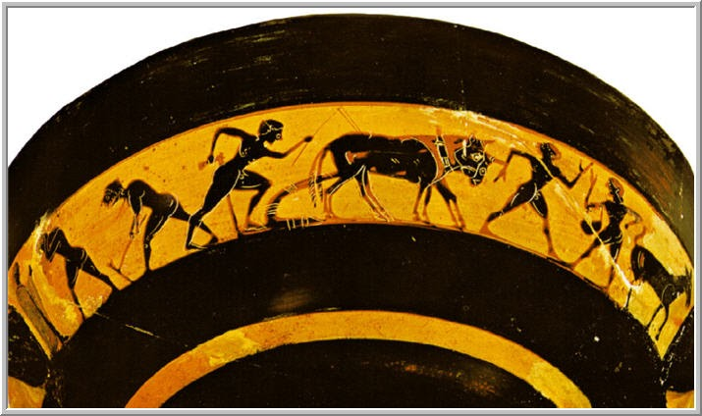
Early civilizations start with agriculture

Slide 60
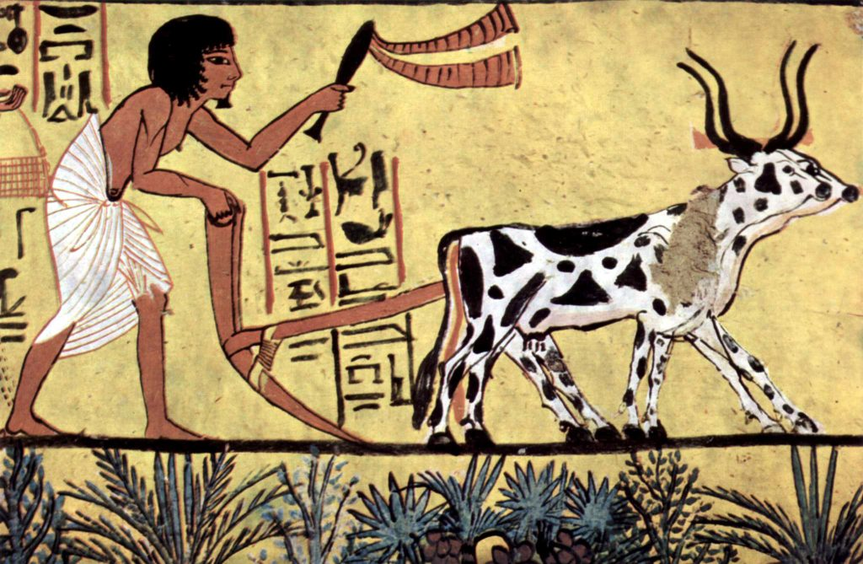
Skills for growing food

Slide 61
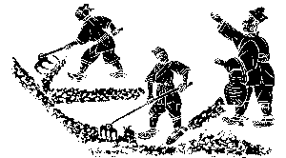

Slide 62
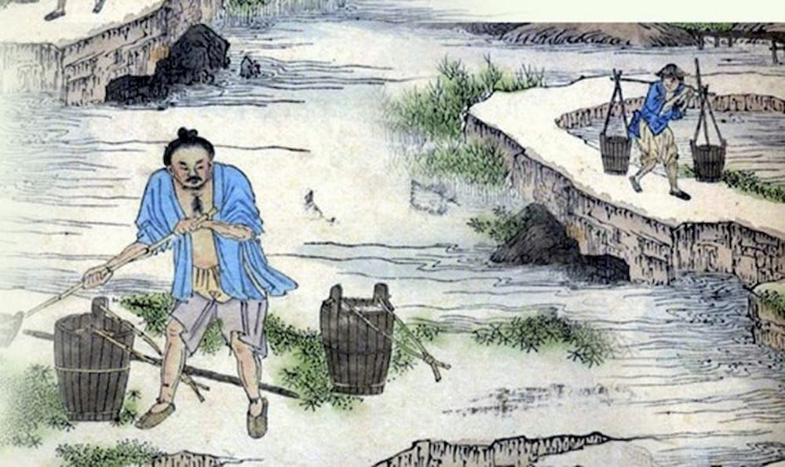

Slide 63


Slide 64
The earliest civilizations: Ancient Greece

Slide 65
Ancient China

Slide 66

Both these civilizations

Slide 67
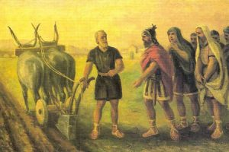
Roughly the same time

Slide 68
About 3,000 years ago

Slide 69
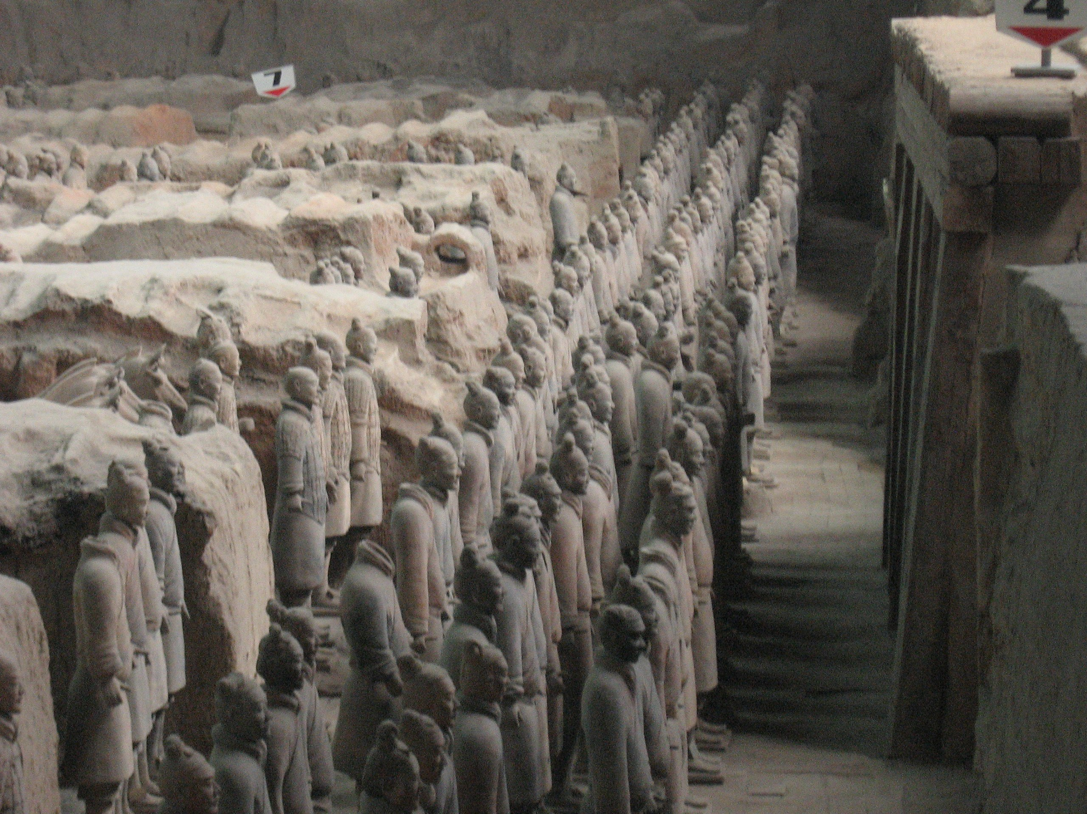
China maybe a bit older

Slide 70
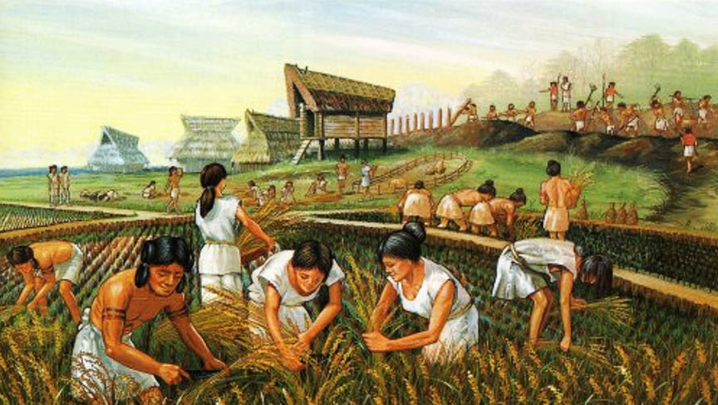
Agriculture required cooperation

Slide 71
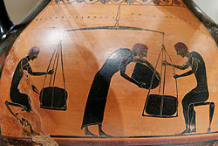
People lived in communities

Slide 72
Worked together

Slide 73
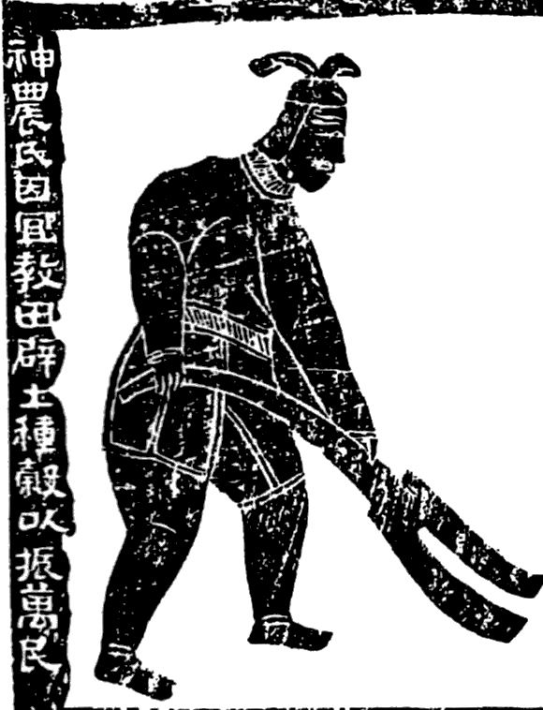
But it seems that rice cultivation needed MORE cooperation

Slide 74
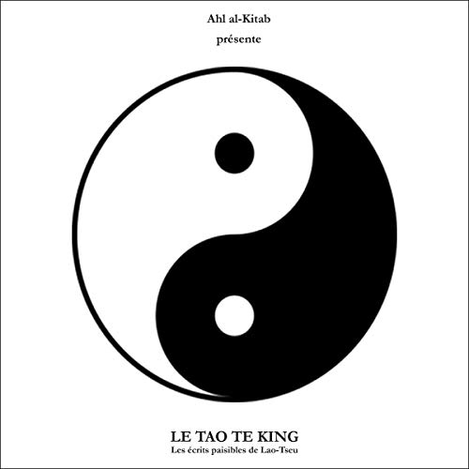
Social harmony became VERY important

Slide 75
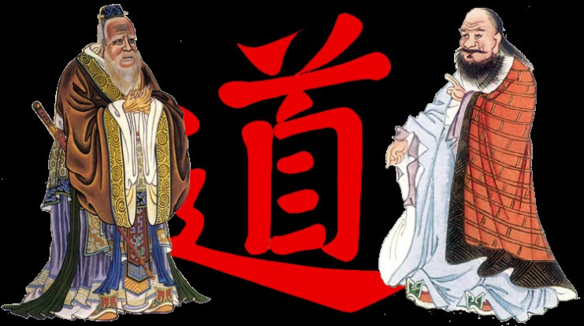
Social harmony and self control

Slide 76
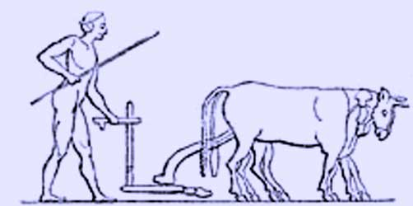
While Greece was different

Slide 77
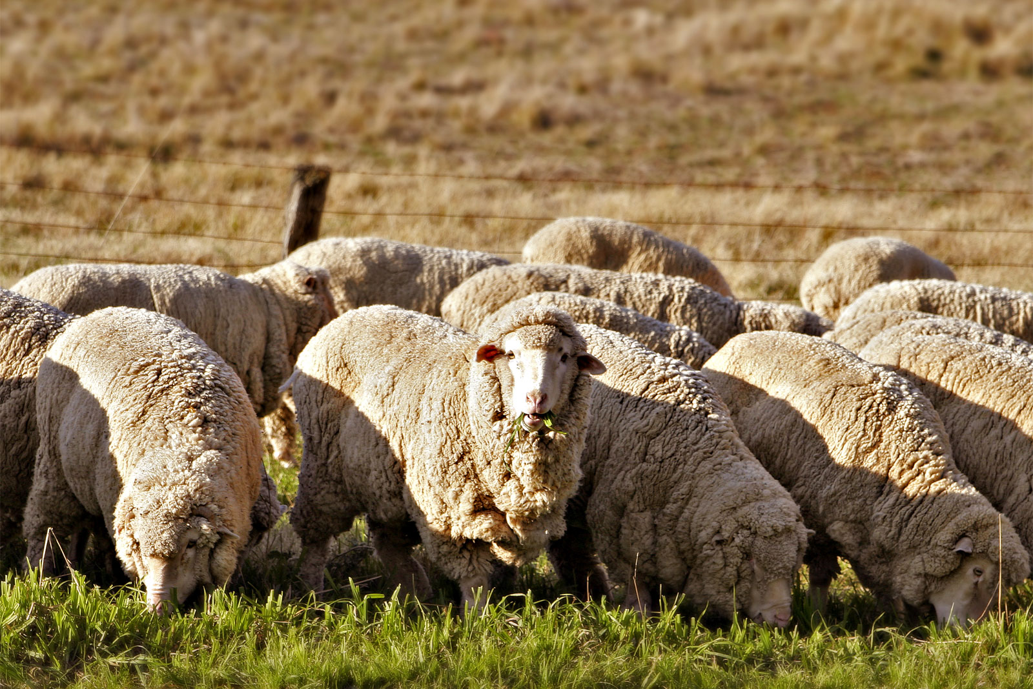
More mixed agriculture

Slide 78
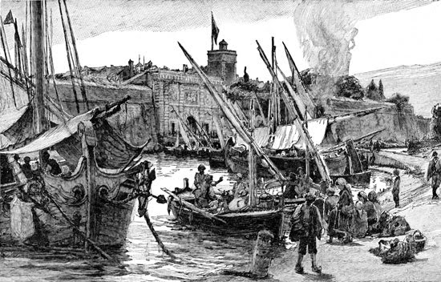
And trade

Slide 79
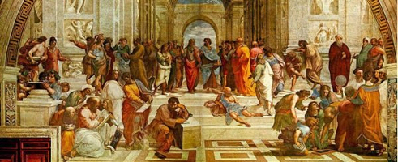
Visitors from many different places

Slide 80
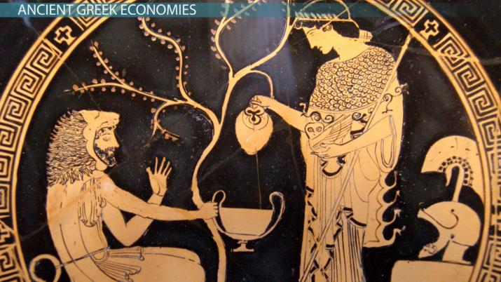
So while cooperation was important in Greece …

Slide 81
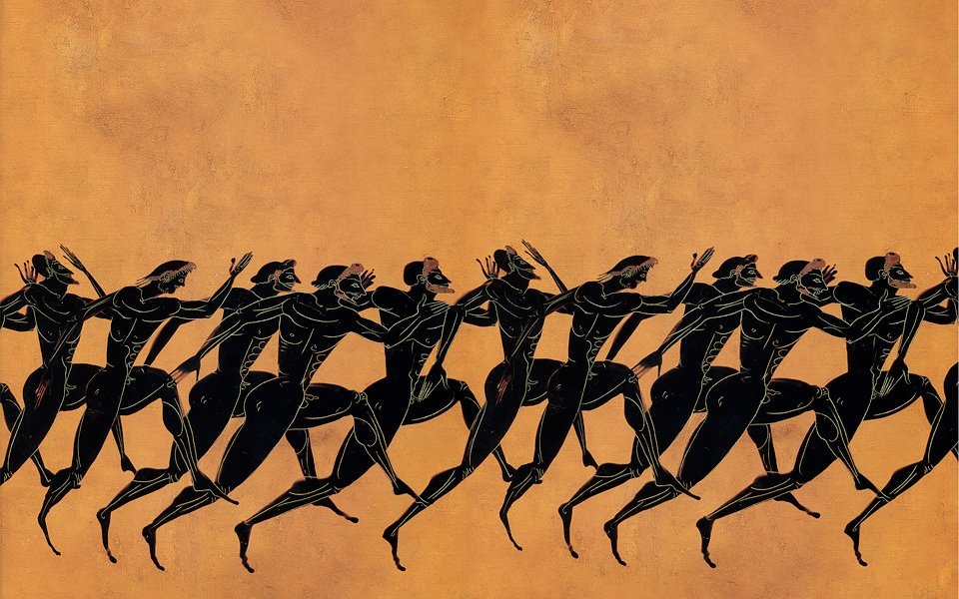
It wasn’t the MOST important thing

Slide 82
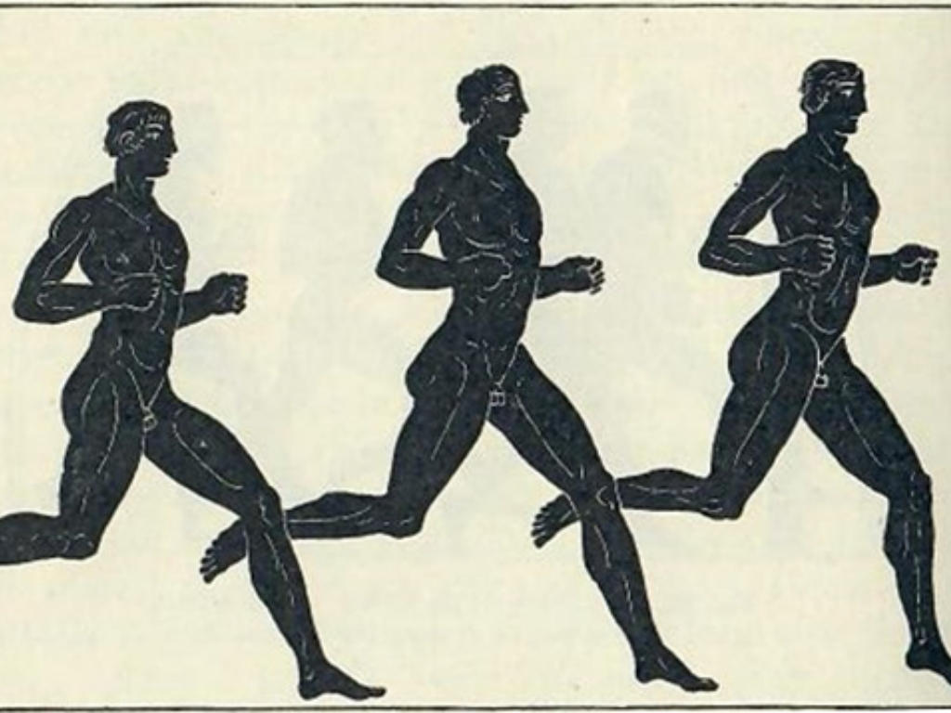
For the Greeks, personal freedom was more important

Slide 83
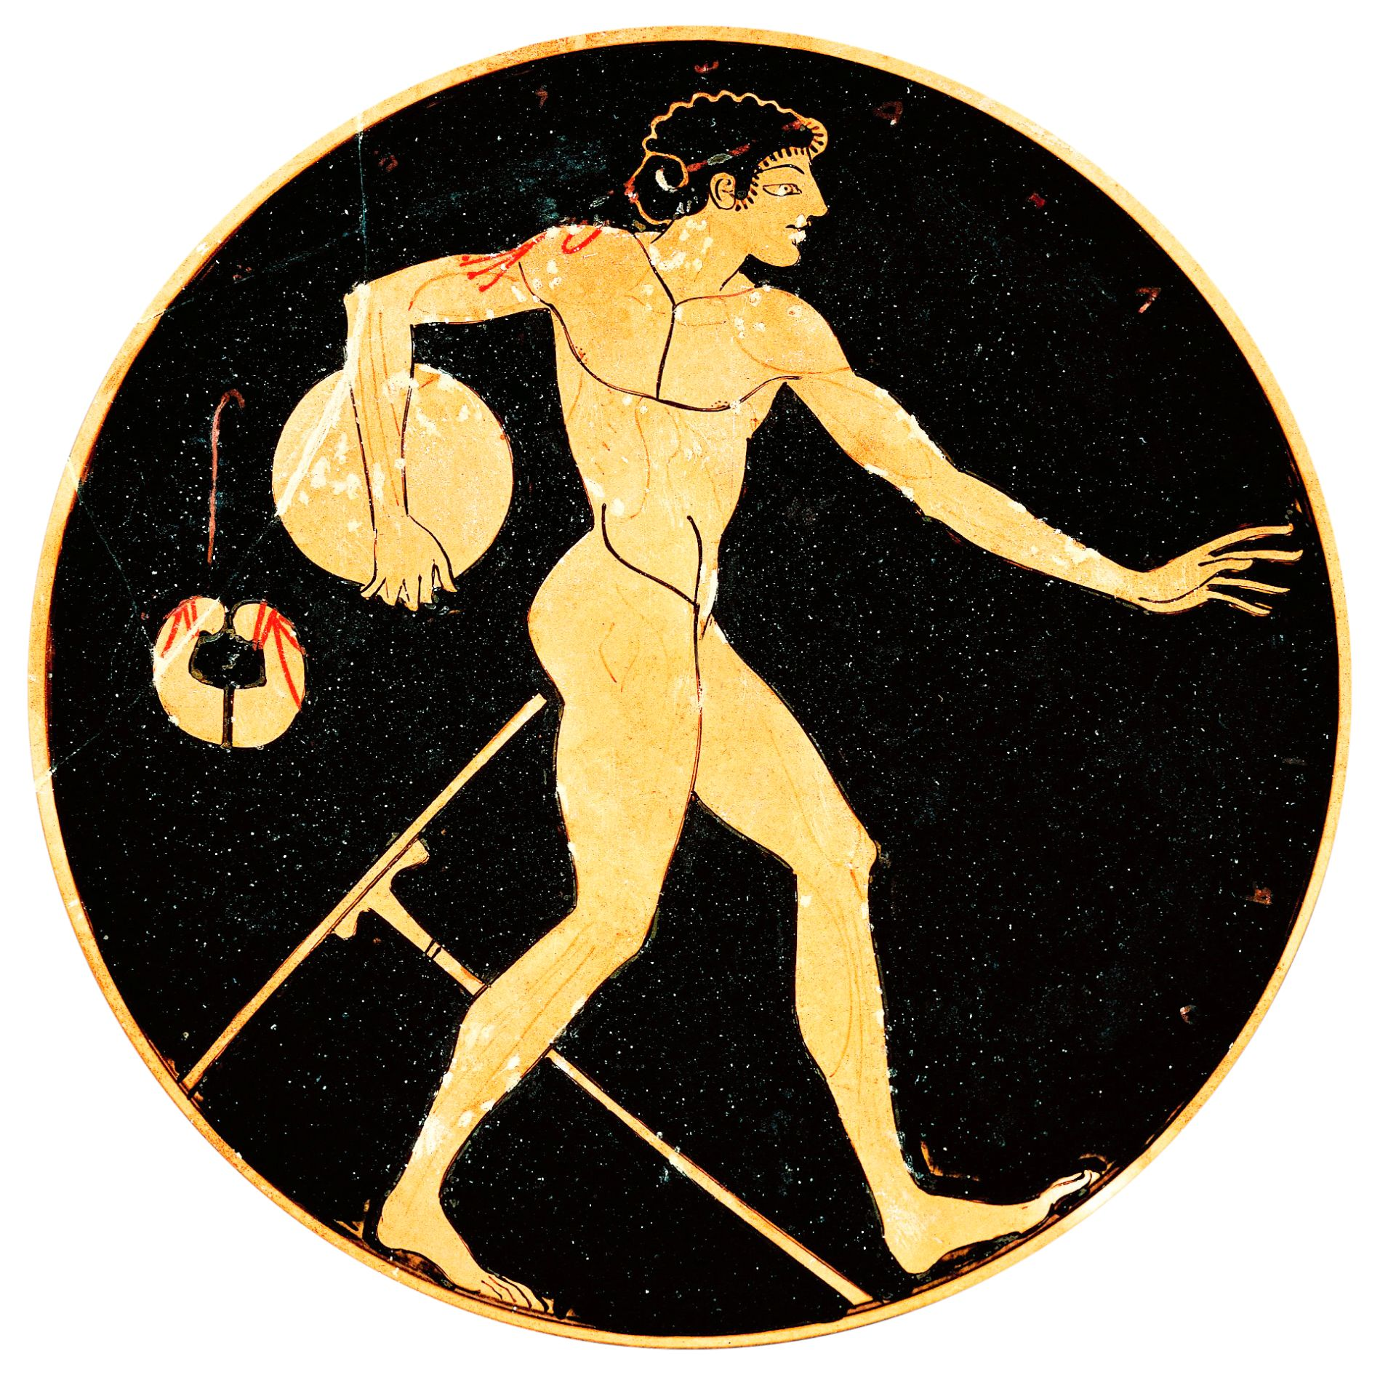
Competition

Slide 84
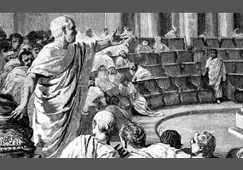
Debate

Slide 85
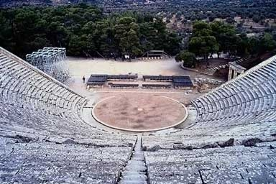
Personal development

Slide 86
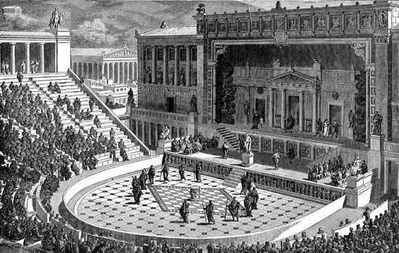
Visits to the theater

Slide 87
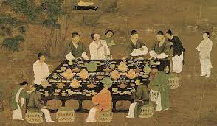
For the Chinese, visiting friends was the preferred leisure activity

Slide 88
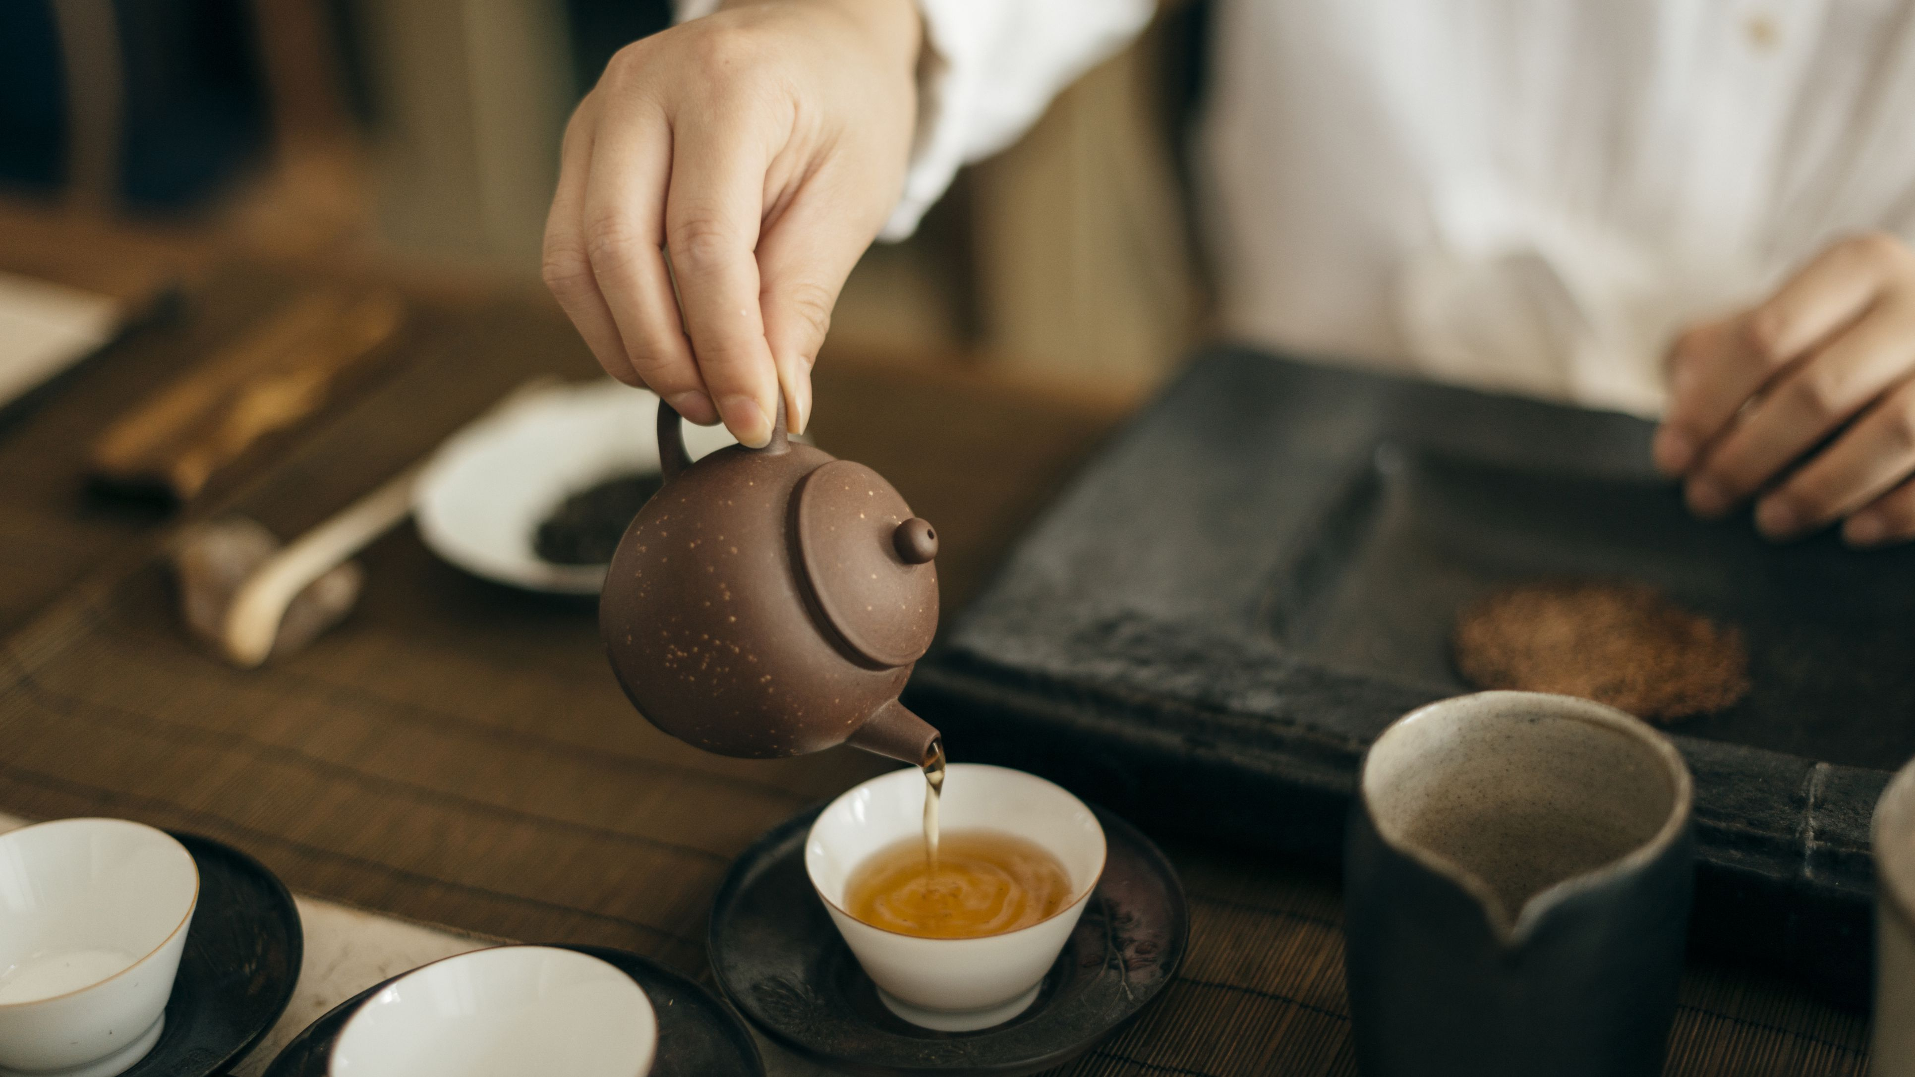
Hospitality was more important

Slide 89
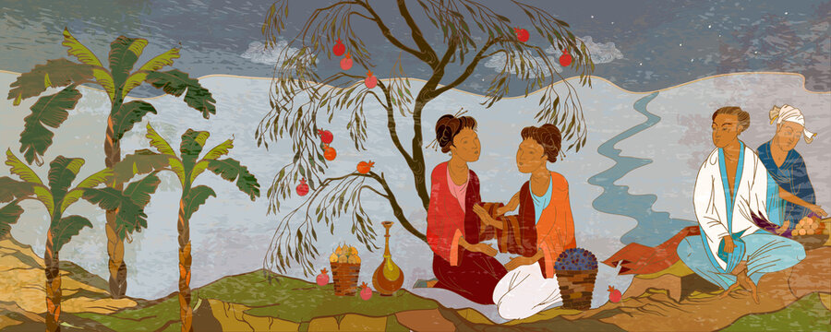
Competition and debate was not encouraged

Slide 90
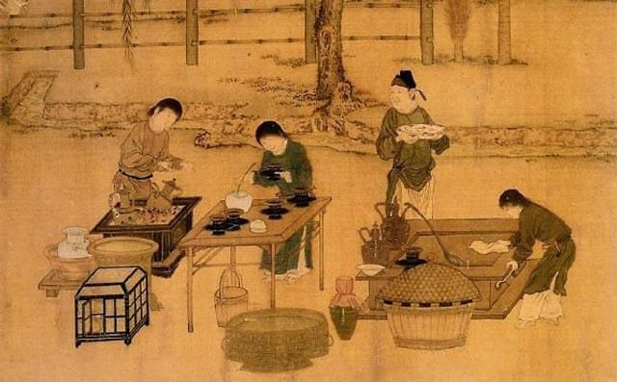
Public disagreement was not good

Slide 91
Unlike Greece

Slide 92
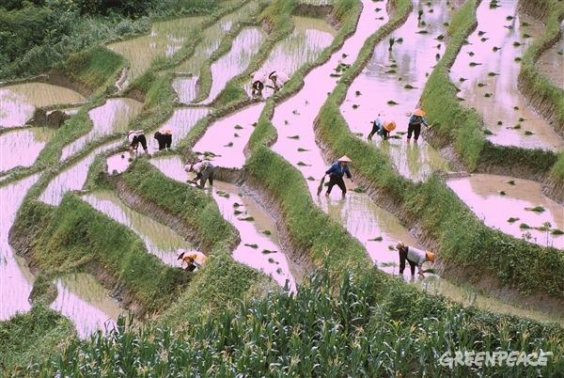
Social disharmony could be very damaging

Slide 93

Different values – different priorities

Slide 94

Sometimes it goes too far

Slide 95

Kind of crazy

Slide 96

Personal freedom as the highest value

Slide 97

Freedom!

Slide 98
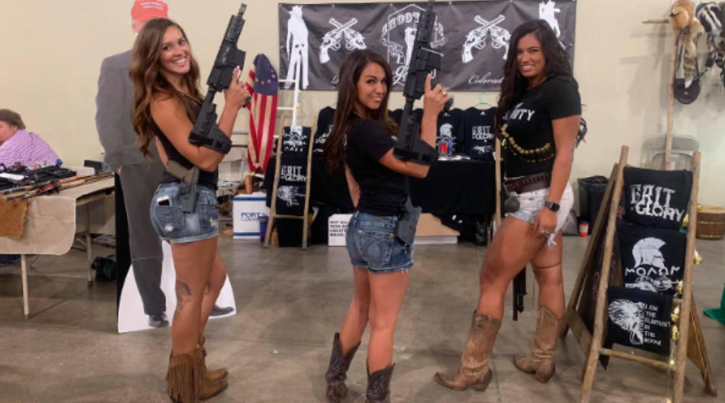
Lauren Boebert: American politician!

Slide 99

How do you communicate with these people?

Slide 100
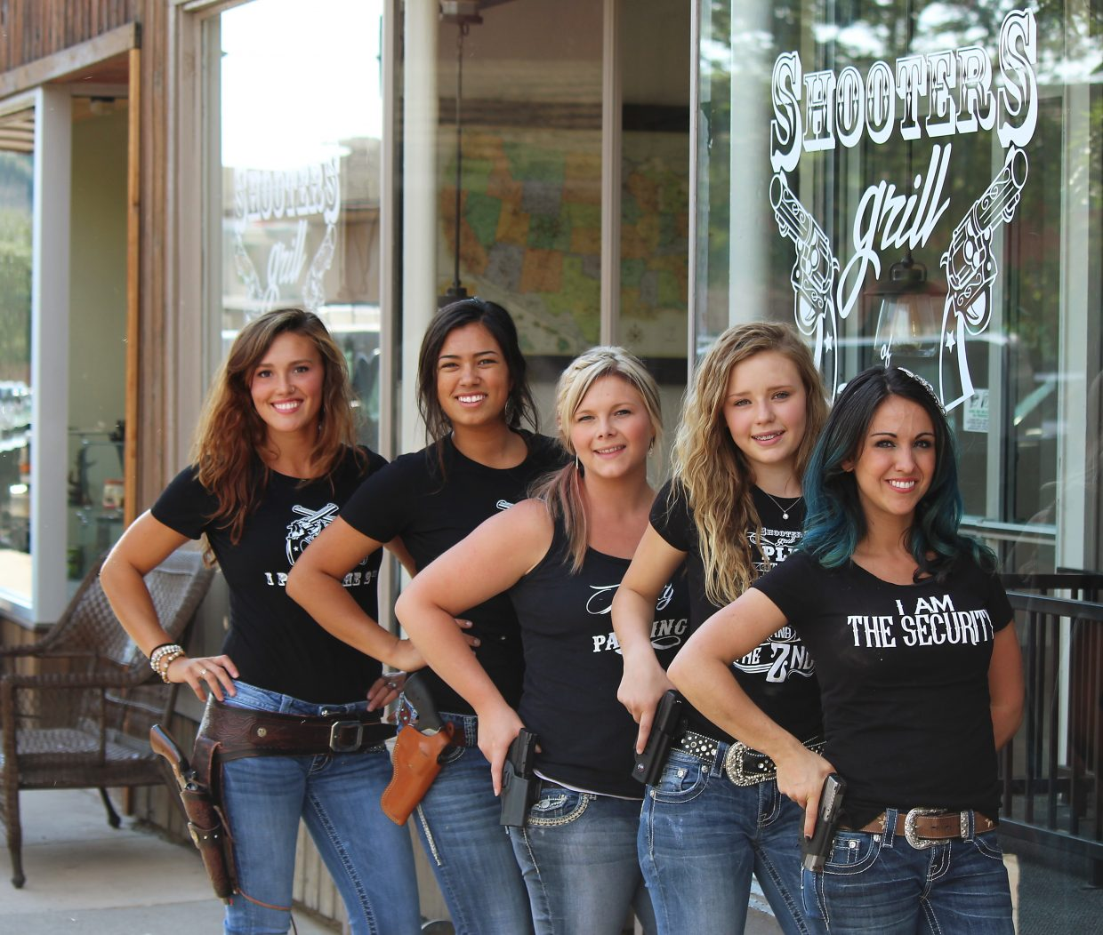
Well, maybe you can’t

Slide 101
As I said, this is the problem!

Slide 102
Hearing and listening

Slide 103
Hearing and listening: not the same

Slide 105
Listening is the key skill

Slide 106
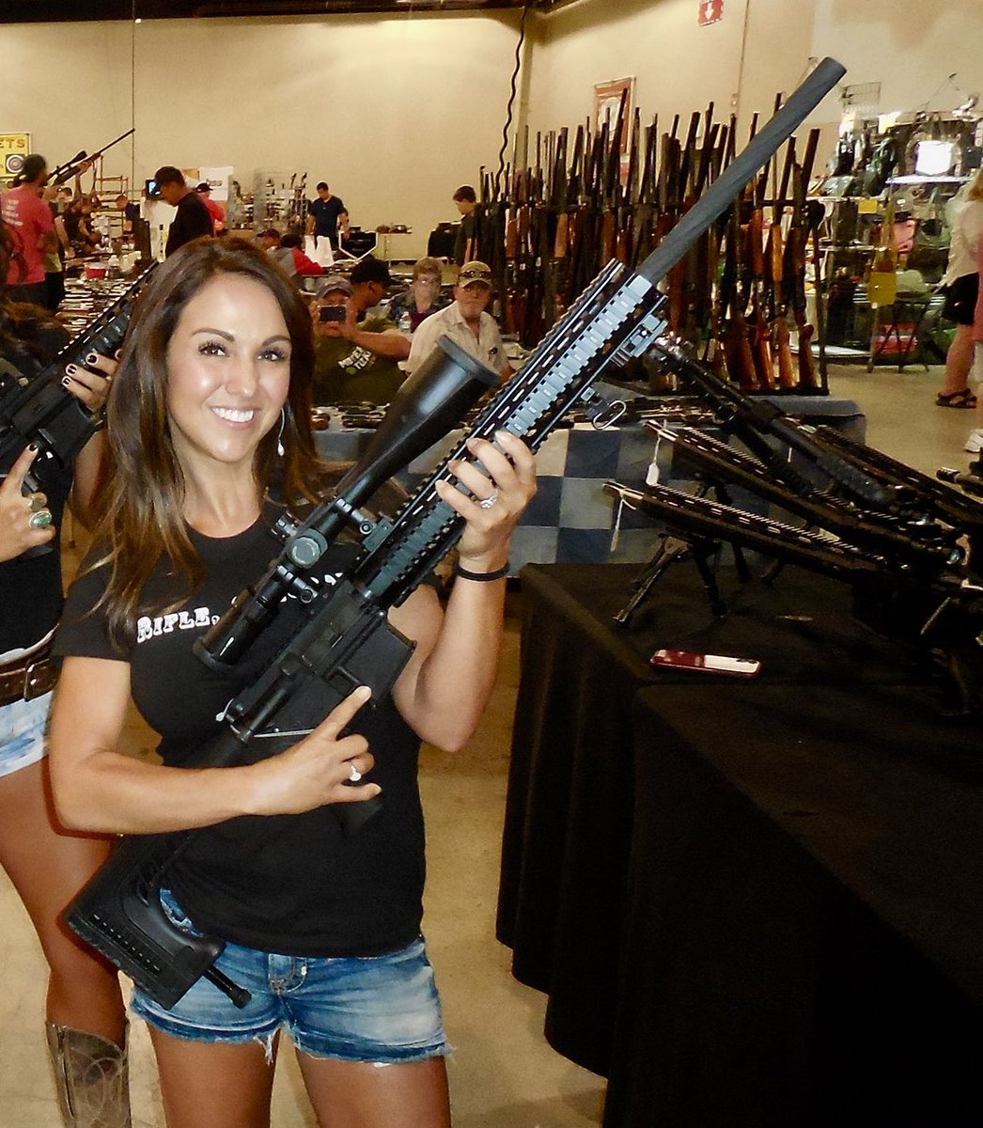
If people are not listening, communication is a problem

